Slide 1

ADAPTIS
SOFTWARE ENGINEERING PROJECT
ADAPTIS
An Adaptive, Network-Aware
Mobile E-Learning Platform for
Low-Connectivity Environments
COURSE
COURSE LECTURER
CEF 440 – Internet and Mobile Programming
Dr. Nkemeni Valery
01 / 12

Slide 2

ADAPTIS
Divine Jembong Tabi Ndip
FE23A035
THE TEAM
Lena Keziah Abanda Gha
FE23A081
Group 18
Menye Ewodo Germaine Laeticia
FE23A092
Five contributors
Nkongho Elizabeth Agbor-Manyo
FE23A122
Tando Calvin Nkuh
FE23A159
CEF 440 · ADAPTIS
02 / 12

Slide 3
ADAPTIS
INTRODUCTION · BACKGROUND
Learning that works without
stable internet
Online learning has become essential,
but many students in Cameroon
struggle due to poor internet
connectivity and expensive
mobile data.
Most existing learning platforms
assume stable internet, making them
unsuitable for low-connectivity
environments.
CEF 440 · ADAPTIS
03 / 12

Slide 4
ADAPTIS
PROBLEM STATEMENT · SOLUTION
Survey findings
95%
97%
90%
experience poor or average
connectivity.
regularly encounter
network problems.
have abandoned a lesson due
to poor internet.
OUR
SOLUTION
Adaptis automatically adjusts lesson quality based on network conditions while
supporting offline learning and progress synchronization.
04 / 12

Slide 5




ADAPTIS
SDLC · PHASE 01
REQUIREMENTS & ANALYSIS
Requirements engineering
Agile development methodology
Survey of 59 respondents
Functional & non-functional
requirements
Stakeholder analysis
CEF 440 · ADAPTIS
05 / 12

Slide 6
ADAPTIS
SDLC · PHASE 02
REQUIREMENT PRIORITIZATION
Key features identified
01
02
03
04
05
Adaptive content
Offline learning
Automatic
Secure
Mobile-first
delivery
progress saving
authentication
design
PRIORITIZATION
MoSCoW technique — Must, Should, Could, Won't
06 / 12

Slide 7
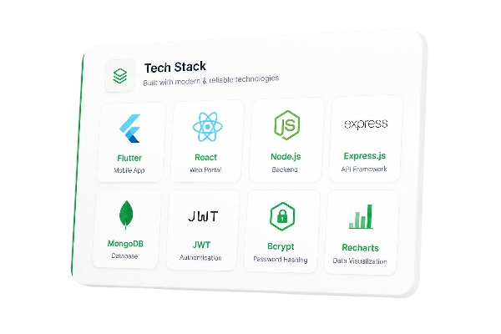

ADAPTIS
SDLC · PHASE 03
SYSTEM DESIGN
Architecture & stack
A modular architecture pairing an adaptive mobile client
with a scalable backend and flexible data layer.
MOBILE
Flutter
System Architecture Diagram
Place the architecture diagram here
WEB
React.js
BACKEND
Node.js
DATABASE
MongoDB
07 / 12

Slide 8
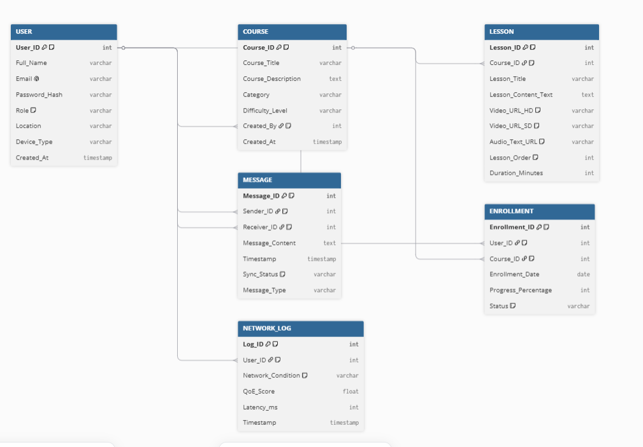

ADAPTIS
SDLC · PHASE 03
UML & DATABASE DESIGN
Modeling the system
Behavior and structure captured through standard UML
diagrams and a relational data model.
Use case diagram
UML / ER Diagram
Place UML & database diagrams here
Class diagram
Sequence diagram
Activity diagram
Entity Relationship (ER) diagram
08 / 12

Slide 9
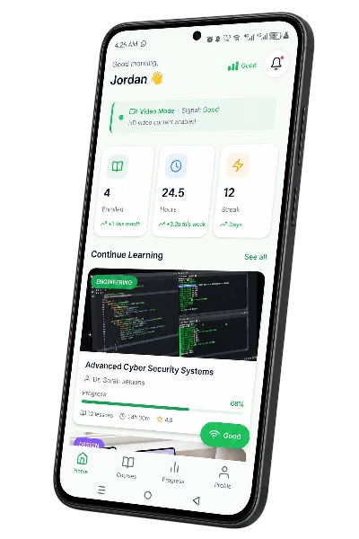





ADAPTIS
SDLC · PHASE 04
IMPLEMENTATION · MOBILE APP
The Adaptis mobile
app
Adaptive lesson streaming
Mobile App Screenshot
Offline content access
Place the app screenshot here
Automatic progress synchronization
Clean, user-friendly interface
09 / 12

Slide 10


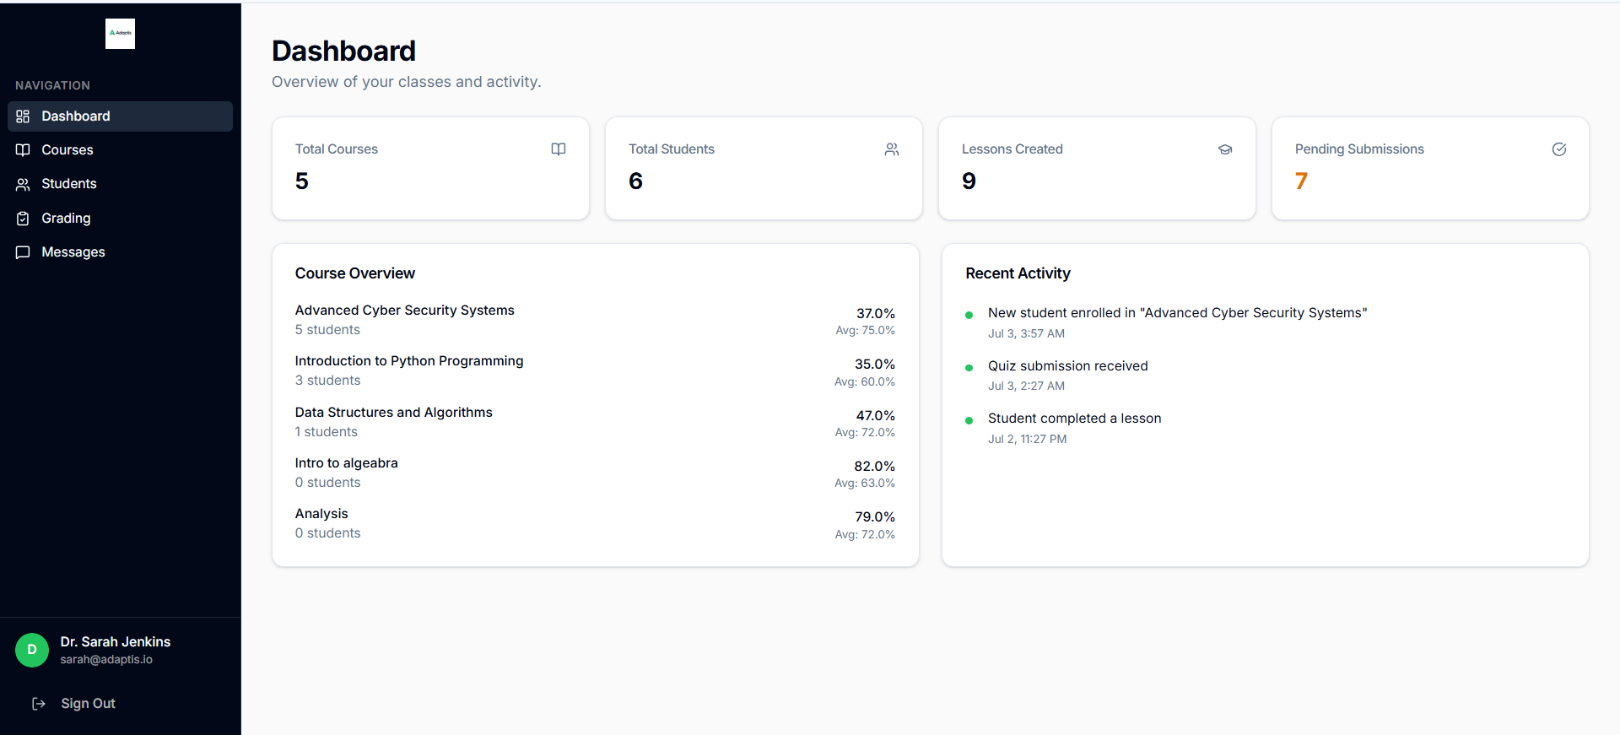
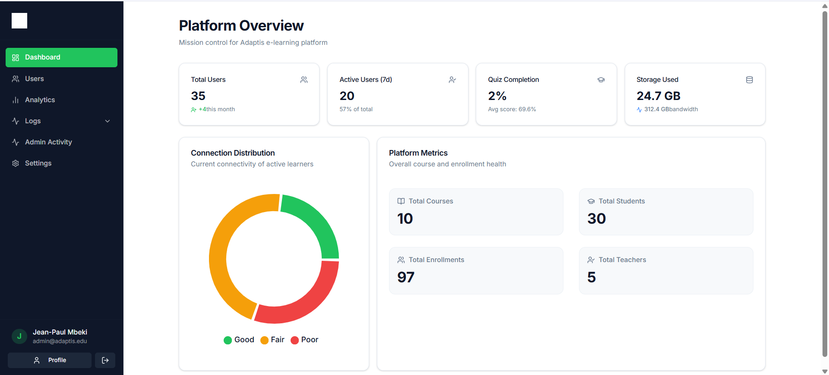
ADAPTIS
SDLC · PHASE 04
IMPLEMENTATION · WEB PLATFORM
Two portals, one platform
Teacher Portal
Admin Portal
Upload lessons
Manage users
Manage content
Oversee platform activity
Track students
System governance
Dashboard Screenshot
Dashboard Screenshot
Place teacher dashboard here
Place admin dashboard here
10 / 12

Slide 11


ADAPTIS
SDLC · PHASE 05
TESTING & RESULTS
Validation & outcomes
TESTING APPROACH
RESULTS
Unit testing
Integration testing
Reliable performance in low-bandwidth
conditions
System testing
Usability testing
Smooth offline experience
Positive user feedback
CEF 440 · ADAPTIS
11 / 12

Slide 12
ADAPTIS
CONCLUSION & FUTURE WORK
Bridging the
FUTURE WORK
connectivity gap
1
AI-powered recommendations
2
Support for more content formats
3
Multi-language support
Adaptis addresses a real challenge faced by students in
low-connectivity environments, making digital learning
more accessible and reliable.
4
Improved analytics
5
Wider deployment
Thank you
CEF 440 · ADAPTIS
12 / 12

